Slide 1
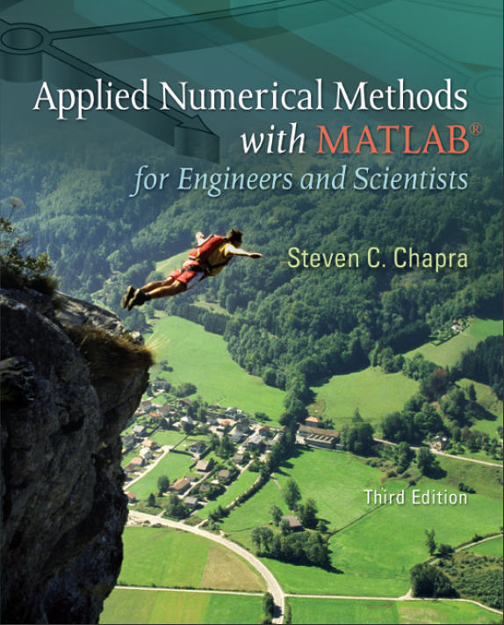
Part 1
Chapter 4
Roundoff and
Truncation Errors
PowerPoints organized by Dr. Michael R. Gustafson II, Duke University and Prof. Steve Chapra, Tufts University
All images copyright © The McGraw-Hill Companies, Inc. Permission required for reproduction or display.

Slide 2
Chapter Objectives
Understanding the distinction between accuracy and precision.
Learning how to quantify error.
Learning how error estimates can be used to decide when to terminate an iterative calculation.
Understanding how roundoff errors occur because digital computers have a limited ability to represent numbers.
Understanding why floating-point numbers have limits on their range and precision.

Slide 3
Objectives (cont)
Recognizing that truncation errors occur when exact mathematical formulations are represented by approximations.
Knowing how to use the Taylor series to estimate truncation errors.
Understanding how to write forward, backward, and centered finite-difference approximations of the first and second derivatives.
Recognizing that efforts to minimize truncation errors can sometimes increase roundoff errors.

Slide 4
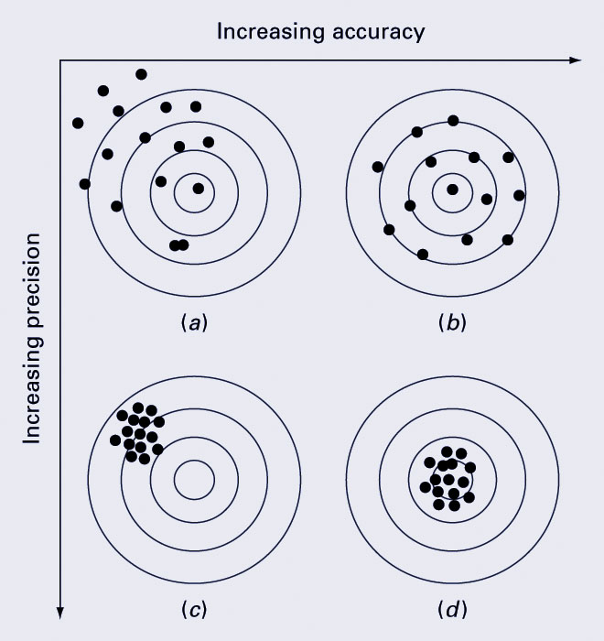
Accuracy and Precision
Accuracy refers to how closely a computed or measured value agrees with the true value, while precision refers to how closely individual computed or measured values agree with each other.
inaccurate and imprecise
accurate and imprecise
inaccurate and precise
accurate and precise

Slide 5
Error Definitions
True error (E_{t}): the difference between the true value and the approximation.
Absolute error (|E_{t}|): the absolute difference between the true value and the approximation.
True fractional relative error: the true error divided by the true value.
Relative error (ε_{t}): the true fractional relative error expressed as a percentage.

Slide 6
Error Definitions (cont)
The previous definitions of error relied on knowing a true value. If that is not the case, approximations can be made to the error.
The approximate percent relative error can be given as the approximate error divided by the approximation, expressed as a percentage - though this presents the challenge of finding the approximate error!
For iterative processes, the error can be approximated as the difference in values between sucessive iterations.

Slide 7
Using Error Estimates
Often, when performing calculations, we may not be concerned with the sign of the error but are interested in whether the absolute value of the percent relative error is lower than a prespecified tolerance ε_{s}. For such cases, the computation is repeated until
| ε_{a} |< ε_{s}
This relationship is referred to as a stopping criterion.

Slide 8
Roundoff Errors
Roundoff errors arise because digital computers cannot represent some quantities exactly. There are two major facets of roundoff errors involved in numerical calculations:
  Digital computers have size and precision limits on their ability to represent numbers.
  Certain numerical manipulations are highly sensitive to roundoff errors.

Slide 9
Computer Number Representation
By default, MATLAB has adopted the IEEE double-precision format in which eight bytes (64 bits) are used to represent floating-point numbers:
n = ±(1+f) x 2e
The sign is determined by a sign bit
The mantissa f is determined by a 52-bit binary number
The exponent e is determined by an 11-bit binary number, from which 1023 is subtracted to get e

Slide 10
Floating Point Ranges
Values of −1023 and +1024 for e are reserved for special meanings, so the exponent range is −1022 to 1023.
The largest possible number MATLAB can store has
  f of all 1’s, giving a significand of 2 − 2⁻⁵², or approximately 2
  e of 11111111110₂, giving an exponent of 2046 − 1023 = 1023
  This yields approximately 2¹⁰²⁴ = 1.7997×10³⁰⁸
The smallest possible number MATLAB can store with full precision has
  f of all 0’s, giving a significand of 1
  e of 00000000001₂, giving an exponent of 1−1023 = −1022
  This yields 2⁻¹⁰²² = 2.2251×10⁻³⁰⁸

Slide 11
Floating Point Precision
The 52 bits for the mantissa f correspond to about 15 to 16 base-10 digits. The machine epsilon - the maximum relative error between a number and MATLAB’s representation of that number, is thus
2⁻⁵² = 2.2204×10⁻¹⁶

Slide 12
Roundoff Errors with
Arithmetic Manipulations
Roundoff error can happen in several circumstances other than just storing numbers - for example:
  Large computations - if a process performs a large number of computations, roundoff errors may build up to become significant
  Adding a Large and a Small Number - Since the small number’s mantissa is shifted to the right to be the same scale as the large number, digits are lost
  Smearing - Smearing occurs whenever the individual terms in a summation are larger than the summation itself.
    (x + 10⁻²⁰) − x = 10⁻²⁰ mathematically, but
    x = 1; (x + 10⁻²⁰) − x gives a 0 in MATLAB!

Slide 13
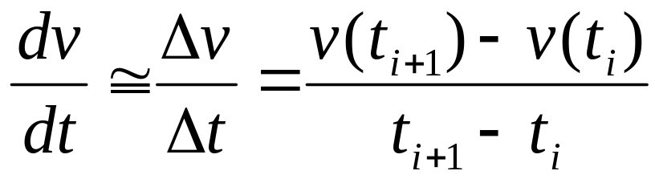
Truncation Errors
Truncation errors are those that result from using an approximation in place of an exact mathematical procedure.
Example 1: approximation to a derivative using a finite-difference equation:
Example 2: The Taylor Series

Slide 14
The Taylor Theorem and Series
The Taylor theorem states that any smooth function can be approximated as a polynomial.
The Taylor series provides a means to express this idea mathematically.

Slide 15
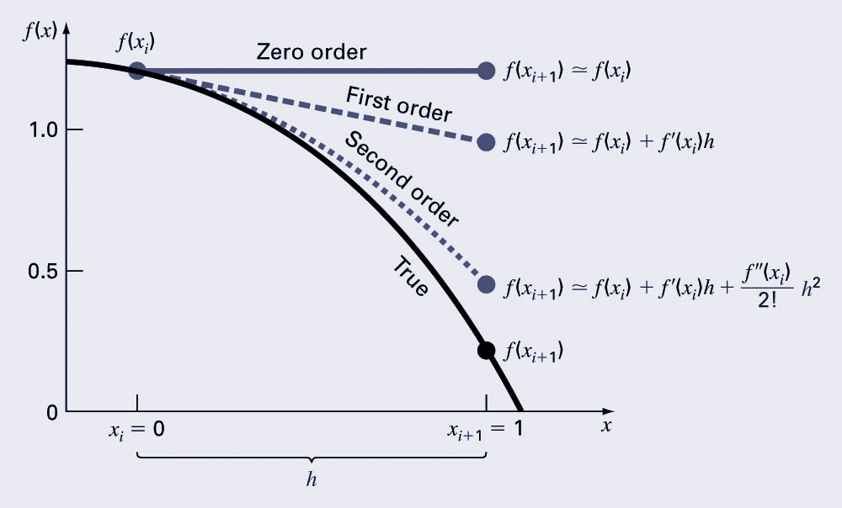
The Taylor Series

Slide 16
Truncation Error
In general, the nth order Taylor series expansion will be exact for an nth order polynomial.
In other cases, the remainder term R_{n} is of the order of h^{n+1}, meaning:
  The more terms are used, the smaller the error, and
  The smaller the spacing, the smaller the error for a given number of terms.

Slide 17

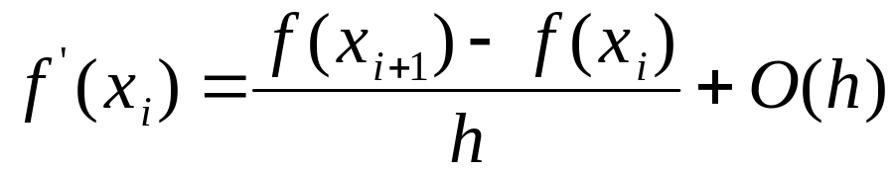
Numerical Differentiation
The first order Taylor series can be used to calculate approximations to derivatives:
  Given:
  Then:
This is termed a “forward” difference because it utilizes data at i and i+1 to estimate the derivative.

Slide 18
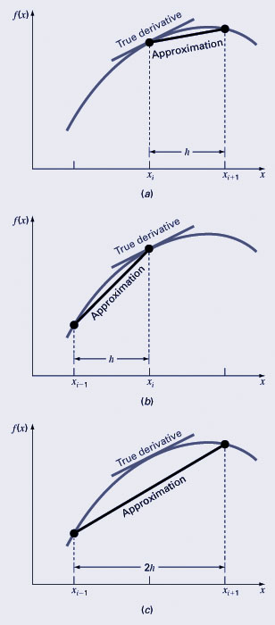
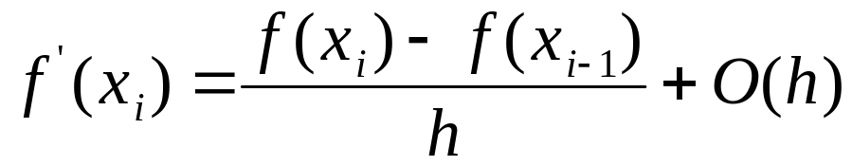
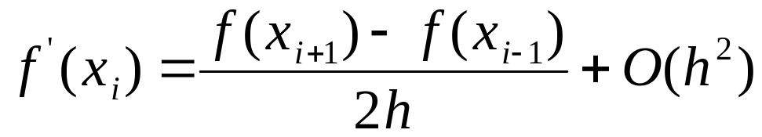
Differentiation (cont)
There are also backward and centered difference approximations, depending on the points used:
Forward:
Backward:
Centered:

Slide 19
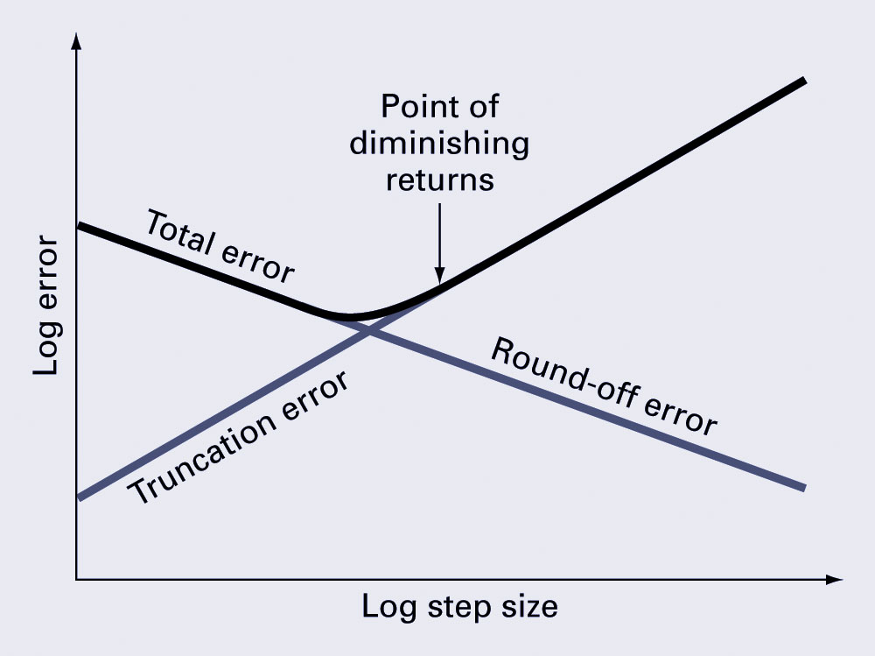
Total Numerical Error
The total numerical error is the summation of the truncation and roundoff errors.
The truncation error generally increases as the step size increases, while the roundoff error decreases as the step size increases - this leads to a point of diminishing returns for step size.

Slide 20
Other Errors
Blunders - errors caused by malfunctions of the computer or human imperfection.
Model errors - errors resulting from incomplete mathematical models.
Data uncertainty - errors resulting from the accuracy and/or precision of the data.

